Slide 1
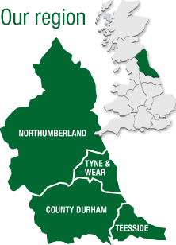


The social impact and return on investment of the Cadet Forces
North of England RFCA Autumn Meeting
20 November 2020

Slide 2
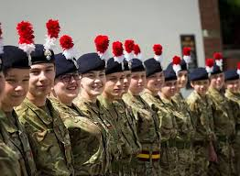
The Cadet Forces Mission is ‘To prepare Cadets for success in their chosen way of life, increasing their awareness and understanding of the Armed Forces and their role in society by delivering enjoyable, well-organised, military-themed activities in a challenging and safely-managed environment’.
Extract from JSP 20814

Slide 3

Research Questions
What is the social impact resulting from the UK (MoD) spending c. £200M p.a. on Cadet Forces?
What is the social impact of the Cadet Expansion Programme (CEP) on the individuals who join the cadet units, their schools, the CFAVs, their local communities and wider society?
What are the benefits of the qualifications provided by CVQO to cadets and Cadet Force Adult Volunteers?
Longitudinal project over four years August 2016 to July 2020
Final report now with MOD Youth and Cadet Team

Slide 4

Methodology and Data
Semi-structured interviews with over 640 cadets, CFAVs, parents, school staff and governors
Self-completion on-line or paper survey cadets, CFAVs and Headteachers (5,500+)
Economic analysis using primary and secondary data to evaluate the social impact of the Cadet Forces on cadets and CFAVs
Analysis of relevant databases inc. Westminster, Bader, CVQO
Review of relevant literature
Enough data for 5 x PhDs!

Slide 5
National Context: We have a problem
‘Mental Health of Children and Young People in England 2017’ (NHS)
mental health of young people is ‘a cause for concern’
In 2017 13% 5-to 19-years old had at least one mental disorder
Mental disorder increases with age: 5.5% of 2 to 4-year-old children, but 16.9% of 17 to 19 years old;
Emotional disorders have become more common in five to 15-year-olds
https://digital.nhs.uk/data-and-information/publications/statistical/mental-health-of-children-and-young-people-in-england/2017/2017

Slide 6
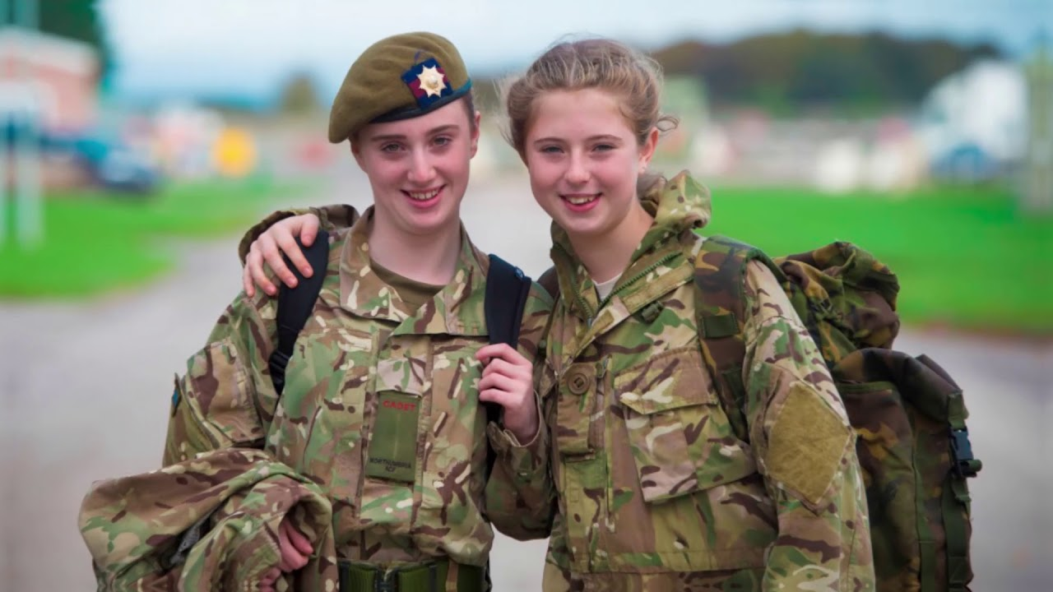
For these two, and 129,998 others, being a cadet develops:
the ability to communicate clearly,
the ability to lead a group,
the resilience to keep going,
the ability to work as a member of a team,
the ability to use social skills,
the ability to accept diversity and work with different people,
the personal confidence to utilize key skills in different situations and with different people.

Slide 7
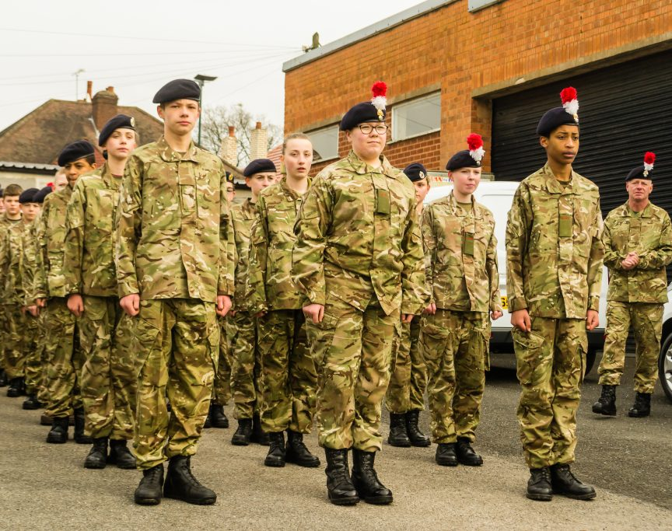
Positive Outcomes of Cadet Forces:
Improved social mobility
More effective education (as a direct consequence of improved attendance and behaviour)
Improved mental and physical wellbeing
Enhanced employability
Reduced vulnerability/increased resilience (to bullying and to criminal and extremist organisations)
Increasingly inclusive communities (ethnic, religious, socio-economic)
Cadets and CFAVs benefit

Slide 8
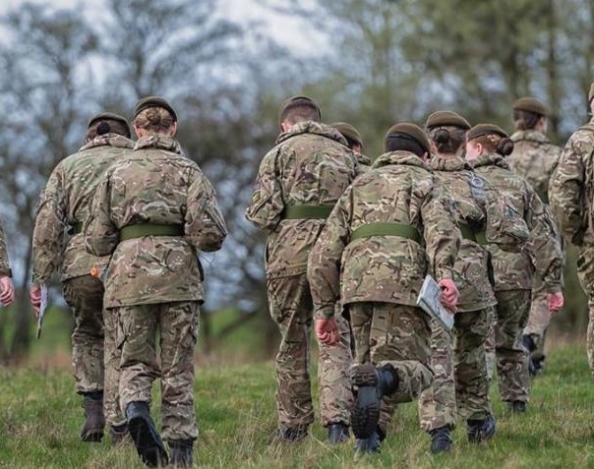
One in 10 cadets are Eligible for Free School Meals (eFSM) or, they are poor
Children that are eFSM score lower in measures of self-esteem and self-efficacy which correlate to poorer academic performance.
70% of eFSM children do not meet expected standards at age 16 (don’t get good GCSEs).
eFSM children 4 x more likely to be excluded from schools than children who are not eFSM.
Only 1% of excluded young people achieve five good GCSEs including English and Maths (DfE 2017g)
Being excluded from school often leads to becoming NEET.
The IPPR estimated in 2017 that the lifetime cost of exclusion is c. £370,000 per individual.

Slide 9

Key Finding of Northampton study
The Cadet Force effect
eFSM national self-efficacy
Non-eFSM self-efficacy
eFSM Cadet Non-eFSM Cadet
self-efficacy self-efficacy
(x 13,000)

Slide 10
Impact of being a cadet for a youngster that is eFSM
Fewer GP visits
Less likely to use mental health services
Life-time benefits in wages
Improved school attendance
Improved school attainment
Vocational qualifications
Self-efficacy improved
Key skills gained
NHS saves £43.11 p.a.
NHS saves £57.92 p.a.
Girls gain £130,844 extra
Boys gain £199,126 extra
School saves £18,500 in exclusion costs (per incident)
Increased tax paid

Slide 11
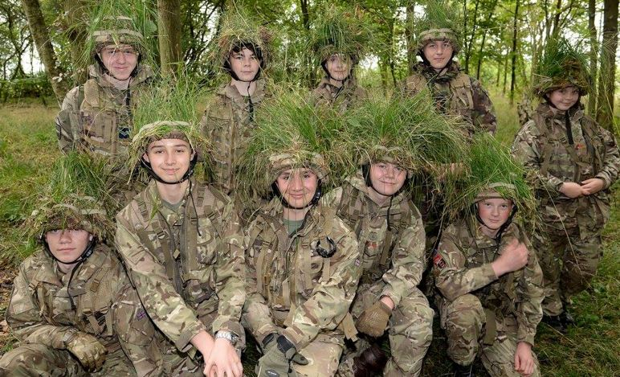
Which one of these will earn £200,000 more as a result of being a cadet?

Slide 12
Value of Wellbeing Impacts p.a.
Young people in the Cadet Forces produce an annual return on investment of c. £83 million as a result of wellbeing increases, made up of:
A reduction in GP visits, worth c. £450,000
A reduction in use of mental health services, worth c. £610,000
Lifetime private benefits from their increased likelihood of attending FE/HE of c. £63,000,000
lifetime public benefits in increased tax receipts from their increased likelihood of attending FE/HE of c. £21,000,000.

Slide 13
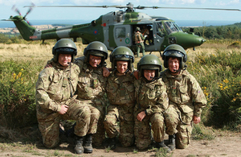
Impact of Cadet Expansion Programme
Having a supported and successful CCF unit in a school:
  Improves attendance (7% boys, 3% girls)
  Attendance improvement increases with time in cadets (5% Yr 9, 8% Yr 11)
  Significant impact on disadvantaged groups attendance (5% English as addition language, 7% eFSM, 7% Pupil Premium)
  Increased attendance strongly linked to increased attainment, particularly among disadvantaged groups
Why does a CCF improve attendance?
Children belong to something bigger than them, or the school.
Sense of identity (uniform etc.)
Role models
Different relationships with teachers
Challenging fun

Slide 14

Value of CVQO awards to eFSM cadets
Gaining 1-2 good GSCEs is associated with significantly increased likelihood of employment and high-wages (lifetime productivity returns £124,412 female, £192,694 men)
Many eFSM children fail to gain any GCSEs
169 female cadets and 328 male cadets that are eFSM gained BTEC or ILM at level 2 in 2018-19
Teachers say that gaining a BTEC or ILM greatly increases the cadets likelihood of gaining good GCSEs
Lifetime value for the 2018-19 cohort of learners = £108.9 million
Figures and calculations are indicative
But, for children from poor homes, CVQO qualifications have great importance

Slide 15
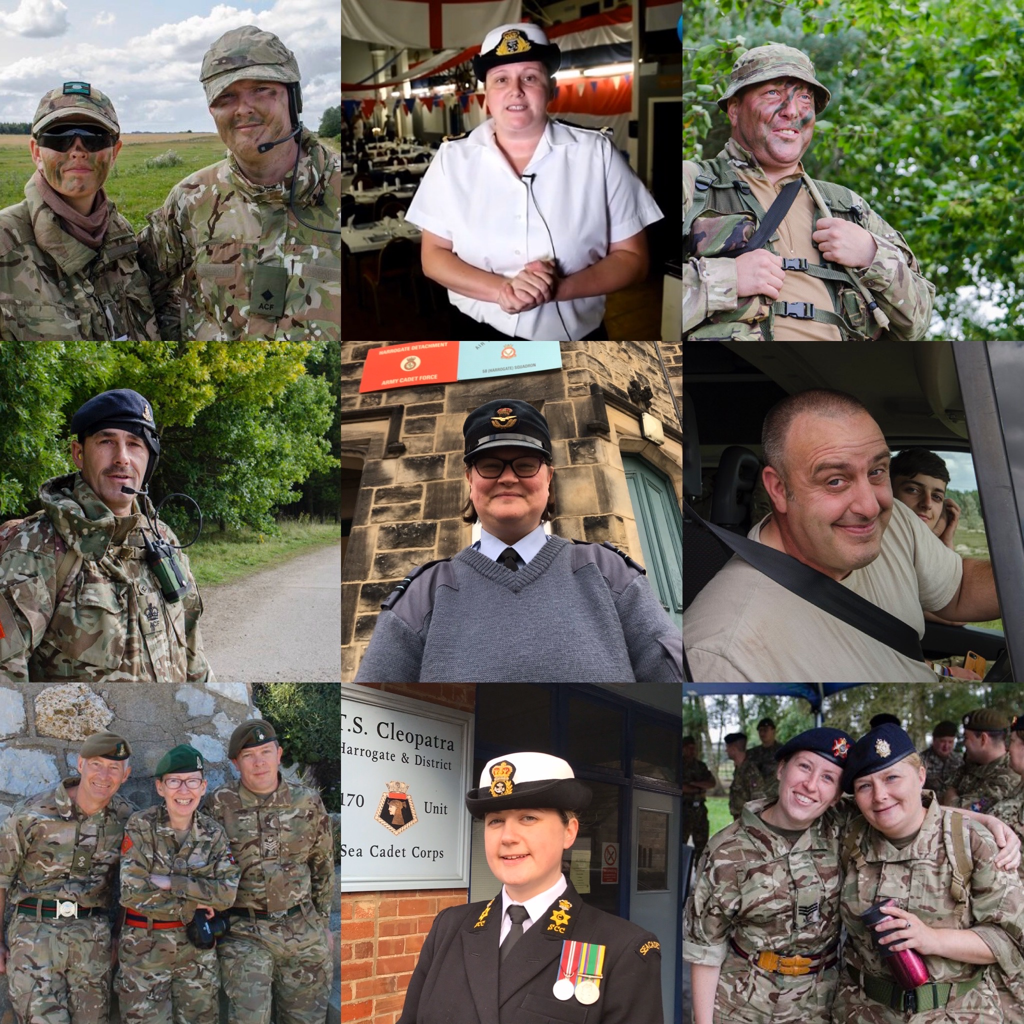
CFAV data highlights
22 item survey of CFAVs (n = 353)
Male = 70%, Female = 30%*
CFAVs that were cadets = 66%
CFAVs that were in HM Forces = 30% (majority ex-Army)
Ex HM Forces CFAVs were nearly all cadets themselves!
CFAVs that are employed = 91%
Employers that actively support CFAV role = 67%
CFAVs with CVQO qualifications = 30% (participation varies widely)
97% of CFAVs that are teachers, social workers or in the police believe that participation in the Cadet Forces is particularly beneficial for disadvantaged youngsters
*MOD sponsored Cadet Force Statistics 2019 has very similar percentages

Slide 16
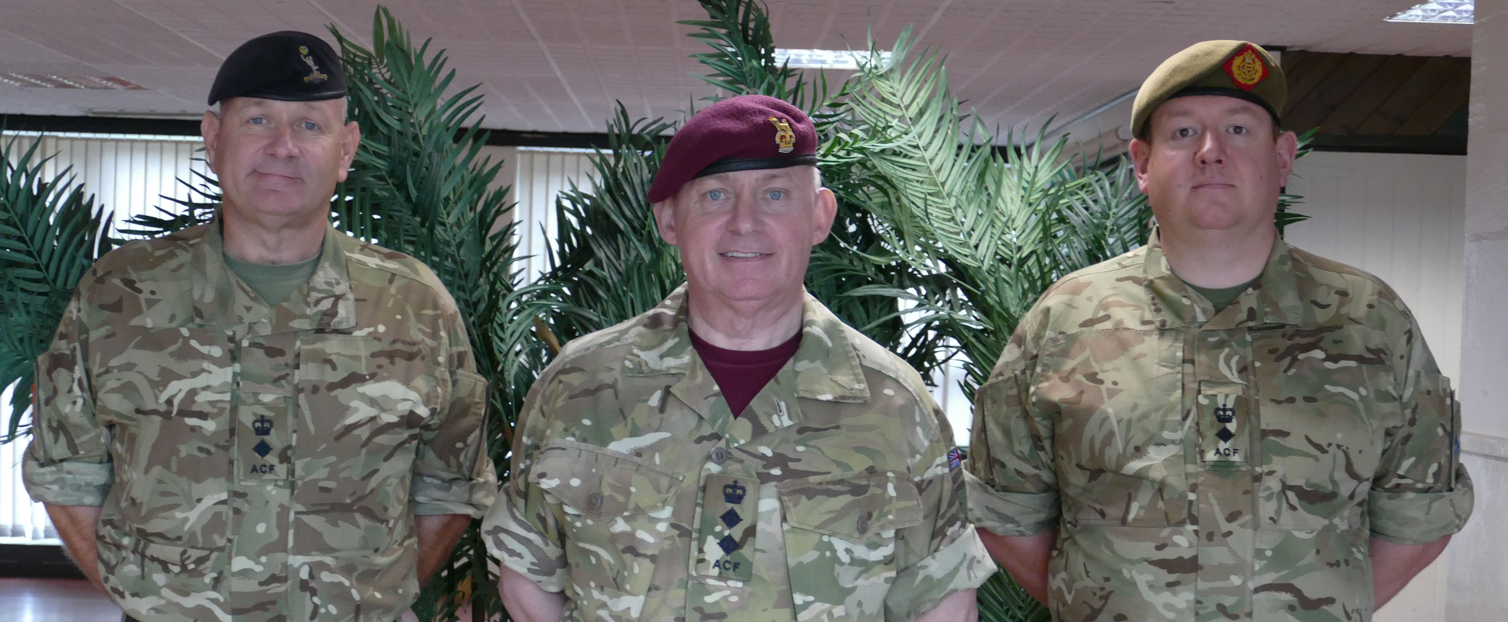
Value of Adult Volunteering
Simple model – minimum wage (Community Works): multiply CFAV hours x minimum wage Total = c. £91 million p.a.
Sophisticated model – life satisfaction (Fujiwara et al 2013): frequent volunteers (i.e. CFAVs) gain £16,335 of benefit p.a. Total = c. £453 million p.a.
Conclusion: the value of the time, energy and effort CFAVs put into the Cadet Forces is enormous, as is the benefit they gain!

Slide 17
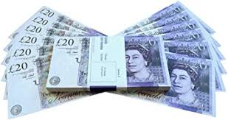

Government Departments benefiting from Cadet Force outcomes
MOD
DfE
DWP
Health and Social Care
HMRC
Housing, Communities and Local Govt.
Home Office

Slide 18
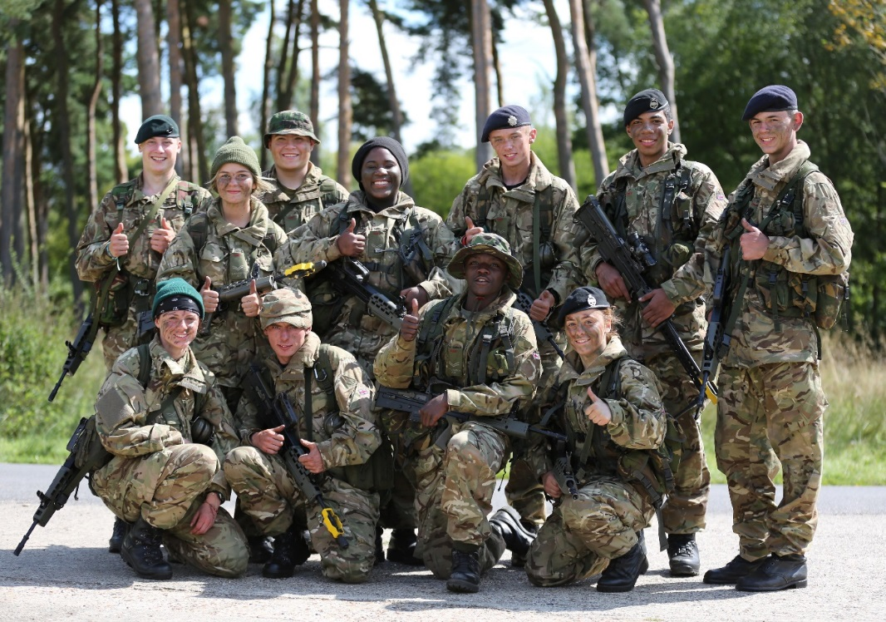
The Cadet Forces Difference
£200,000,000 = cost of Cadet Forces p.a.
£370,000 = lifetime cost of exclusions (IPPR 2017)
540 = annual number of young people the Cadet Forces has to change life outcomes for to cover annual cost of Cadet Forces
130,000 = number of cadets in April 2020
Big numbers, Small number, Big number

Slide 19
Conclusions
The Cadet Forces provide challenge, discipline, fun, structure, education, training and opportunity
All cadets can benefit
Those cadets who come from poor homes are able to transform their life-chances.
The work the RFCA, the CFAVs, the Cadet Training Teams, the Regular and Reserve Forces do to run cadet detachments is hugely important
The Cadet Forces are a superb investment for the taxpayer
For them, and 129,998 others!

